Slide 1
Increasing women representation in leadership roles
A pathway to gender equality

Slide 2
Index
Introduction
Facts and figures: Women's involvement in politics and leadership
Why it is important?
How can companies use psychological science to give women greater chances in leadership roles?
What happens when women lead?
What can organizations do to help advance more women into leadership?
Challenges faced by women in leadership and how to overcome them
Strategies to Enhance Women's Representation in Leadership Roles
Conclusion

Slide 3
Introduction
  It's no secret that historically, women have had to overcome more obstacles than men to participate fully in the economy. Disparities between men and women continue to exist in the form of pay gaps, unequal opportunities for advancement, and unequal representation in key decision-making across regions and income levels.

Slide 4
Facts and figures: Women's involvement in politics and leadership
Ensuring women's leadership and equal participation in politics and public life is crucial to reaching the Sustainable Development Goals by 2030. However, statistics indicate that gender parity in politics is still a long way off and that women are underrepresented at all levels of decision-making globally.
Women in executive government positions
Women in national parliaments
Women in local government
Expanding participation

Slide 5
Facts and figures: Women's involvement in politics and leadership
Women in executive government positions
There are 30 women holding the position of Head of State or Government in 29 different countries as of October 1, 2024. It will take another 130 years to achieve gender equality in the highest positions of power at the current rate.
There are only 19 nations with female heads of state and 17 with female heads of governments.
As of January 1, 2024, women make up 23.3% of Cabinet members who are in charge of Ministries and a policy domain, according to data gathered by UN Women. Only fifteen nations have at least 50% of their Cabinet Ministers be female leaders of key policy areas.
Women and gender equality, family and children affairs, social inclusion and development, social protection and social security, and Indigenous and minority affairs are the five portfolios that women Cabinet Ministers hold the most frequently.

Slide 6
Facts and figures: Women's involvement in politics and leadership
Women in national parliaments
Women now make up only 26.9% of lawmakers in single or lower houses, compared to 11% in 1995.
Only six nations—Rwanda (61%), Cuba (56%), Nicaragua (54%), Andorra (50%), Mexico (50%), New Zealand (50%), and the United Arab Emirates (50%)—have 50% or more of their female lawmakers in the single or lower houses of parliament.
22 more nations—13 in Europe, 5 in Africa, 4 in Latin America and the Caribbean, and 1 in Asia-Pacific—have attained or surpassed the 40 percent mark.
There are 21 states in the world where the proportion of female lawmakers in single or lower houses is less than 10%, including two lower chambers where there are no female legislators at all.
Gender parity in national legislative bodies won't be reached before 2063 at the current rate of advancement.
In Latin America and the Caribbean, women account for 36% of parliamentary seats, while in Europe and the North America, they make up 33%. Sub-Saharan Africa has the highest percentage of female legislators (27%), followed by Eastern and South-Eastern Asia (23%), Oceania (20%), Central and Southern Asia, Northern Africa, and Western Asia, where women make up 18% of female MPs in each region.

Slide 7
Facts and figures: Women's involvement in politics and leadership
Women in local government
Information gathered from 145 nations reveals that over 3 million (35.5%) of elected members in local deliberative bodies are women. There are just two nations where the percentage of women in local government has reached 50%, while there are 26 more where the percentage is above 40%.
As of January 2024, the following regional differences were observed regarding the representation of women in local deliberative bodies: 41% in Central and Southern Asia, 37% in Europe and North America, 31% in Oceania, 31% in Eastern and South-Eastern Asia, 29% in Latin America and the Caribbean, 26% in sub-Saharan Africa, and 20% in Western Asia and Northern Africa.

Slide 8
Facts and figures: Women's involvement in politics and leadership
Expanding participation
The Beijing Declaration and Platform for Action set an internationally agreed-upon goal of equal power-sharing between men and women in decision-making and balanced political participation.
Even though gender parity has not been reached in the majority of nations, gender quotas have made significant advancements possible over time. Women's representation in parliaments and local government is five percentage points and seven percentage points higher, respectively, in nations with legally mandated candidate quotas than in those without.
Evidence that women's leadership in political decision-making processes enhances them is both well-established and accumulating. For instance, a study conducted in India on panchayats (local councils) found that the number of drinking water projects was 62% more in areas where women led the council than in areas where men led the council. There is a clear causal link in Norway between childcare coverage and the number of women serving on municipal councils.
Even in the most politically charged settings, women can exhibit political leadership by collaborating across party lines in parliamentary women's caucuses and by standing up for gender equality causes like voting reform, parental leave and childcare, pensions, and the abolition of gender-based violence.

Slide 9
Why it is important?
Everyone gains when more women are given the opportunity to hold leadership roles. Numerous studies conducted over the years have demonstrated the positive effects of women leaders on productivity, collaboration, organizational dedication, and fairness.
But only Ten percent of Fortune 500 companies are led by women, despite these advantages.

Slide 10
How can companies use psychological science to give women greater chances in leadership roles?
A variety of research-supported tactics are available from industrial/organizational (I/O) psychologists to assist in narrowing the gender gap. These consist of early detection of leadership potential, official mentoring and sponsorship programs, and training for men and other powerful individuals to act as allies.
Professor of psychology emerita at Northwestern University and pioneer in the study of women's leadership, Alice Eagly, PhD, stated that "women still face challenges to their authority and success that are greater than those faced by their male counterparts." "Yet, women are steadily rising in corporate, educational, and political leadership roles despite these obstacles."

Slide 11
What happens when women lead?
Psychological research spanning decades confirms that when women are given the opportunity to assume leadership roles, everyone can experience a metamorphosis.
A seminal 1992 meta-analysis of 61 studies led by Eagly found that female leaders exhibit more transformational leadership styles. Compared to men, they are more likely to represent the organization's best qualities and encourage others to support its goals, according to study findings.
According to a 2020 meta-analysis headed by Eagly, women are now viewed as equally or more competent than men. Data from sixteen nationally representative public opinion surveys with over 30,000 American adults were incorporated into the study between 1946 and 2018. The three types of traits the researchers examined were competence (i.e., intelligence, creativity), agency (i.e., ambition, aggression), and communication (i.e., compassion, sensitivity). The researchers also asked participants to rate the degree to which each trait applied more to men or women than to the other.
The findings demonstrated how competence stereotypes evolved over time in a significant way. In a 1946 survey, for instance, only 35% of respondents said that men and women were equally intelligent, and among those who did, more said that men were the more capable sex. On the other hand, according to a 2018 survey, 86% of respondents thought men and women were equally intelligent, 9% thought women were smarter than men, and 5% thought men were smarter than women. Furthermore, over time, societal preconceptions that women are more sensitive and compassionate than men became stronger.

Slide 12
What happens when women lead?
According to a 2010 study, the presence of women in the group significantly improves team collaboration, an effect that is primarily explained by women's benefits to group processes. Organizational psychologist Anita Williams Woolley, PhD, and her colleagues looked at working groups of two to five people in two studies totaling 699 participants. They discovered that the percentage of women in a group was significantly correlated with the group's collective intelligence, or their capacity to collaborate and solve a variety of problems. In terms of conversational turn-taking, groups comprising more women demonstrated greater equality, which further allowed the members to be more receptive to one another and to maximize the knowledge and abilities of the group.

Slide 13
What happens when women lead?
According to a 2010 study, the presence of women in the group significantly improves team collaboration, an effect that is primarily explained by women's benefits to group processes. Organizational psychologist Anita Williams Woolley, PhD, and her colleagues looked at working groups of two to five people in two studies totaling 699 participants. They discovered that the percentage of women in a group was significantly correlated with the group's collective intelligence, or their capacity to collaborate and solve a variety of problems. In terms of conversational turn-taking, groups comprising more women demonstrated greater equality, which further allowed the members to be more receptive to one another and to maximize the knowledge and abilities of the group.

Slide 14
What happens when women lead?
According to a 2022 study led by social psychologist Mansi P. Joshi, PhD, the mere presence of a female leader relative to a male leader led perceivers to anticipate fairer treatment in that organization and greater projected salary and status. In industries where women predominate as well as those where men do, female leaders who also held different positions in the organizational hierarchy fostered organizational trust.
In seven of the eight leadership-relevant traits evaluated in a 2008 Pew Research Center national survey, women score higher than or are on par with men. Twenty percent of respondents thought men were more honest than women, while half of the respondents thought women were more honest than men. About intelligence, 38% of respondents thought women were smarter than men, while only 14% thought men were smarter. Additionally, women were rated as being more gregarious, creative, and compassionate.

Slide 15
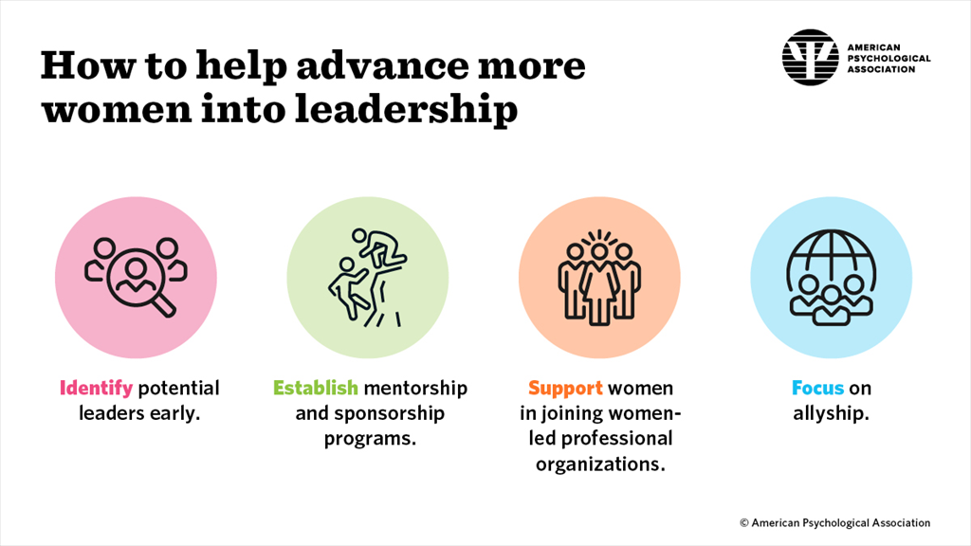
What can organizations do to help advance more women into leadership?

Slide 16
Challenges faced by women in leadership and how to overcome them
It's critical to highlight the subtle but powerful obstacles that prevent women from advancing into leadership positions in the fight for gender equality. These barriers include the following:
Unconscious biases
Stereotypes and societal expectations
Underrepresentation and lack of mentorships
Limited access to high-impact opportunities

Slide 17
Challenges faced by women in leadership and how to overcome them
Unconscious biases:
Unconscious gender biases are ubiquitous and penetrate decision-making processes, subtly endorsing traditional leadership qualities typically associated with men. According to one study, men had a 1.5 times higher chance of getting hired than women in a pool of candidates who performed equally well!
In a similar spirit, women encounter double standards, whereby those in positions of authority are held to higher standards and are expected to behave differently than their male counterparts. Leveling the playing field requires recognizing and opposing these unfair practices.
Fostering an equitable and inclusive leadership landscape requires addressing and eliminating these unconscious biases. Especially at the senior and executive levels, training and awareness campaigns are essential to dispelling gender stereotypes and battling unconscious bias. Furthermore, in order to address the underlying cause of the issue, a thorough examination of the hiring procedures will be necessary to guarantee equitable practices. Find out more about enhancing diversity in hiring.

Slide 18
Challenges faced by women in leadership and how to overcome them
Stereotypes and societal expectations
It can be difficult for women to break free from traditional roles because of societal norms and expectations that limit them to certain roles. It is imperative to eradicate deeply rooted stereotypes in order to enable women to aspire to and succeed in leadership positions.
Women are disproportionately affected by the stigma associated with work-life balance, which makes it difficult for them to strike a balance between their leadership goals and their familial responsibilities. This stigma contributes significantly to the phenomenon known as the "motherhood penalty," which widens the gender pay gap and keeps women from pursuing more demanding leadership positions in a variety of industries.
Organizations must put inclusive policies in place, like flexible work schedules, childcare options, or suitable parental leave policies, in order to overcome these obstacles.

Slide 19
Challenges faced by women in leadership and how to overcome them
Underrepresentation and lack of mentorships
In the absence of prominent individuals who have effectively walked the path to leadership, women might find it difficult to envision their own careers. Sponsors, powerful supporters inside a company, can play a significant role in advancing women's access to important opportunities and fostering their professional development. The lack of these encouraging role models can impede women's advancement and maintain gender disparities in leadership positions.
One strategic step that organizations can take to address this issue and enhance female representation is to establish mentorship programs. Regardless of gender, mentoring offers a structured framework for seasoned professionals to mentor and assist their less seasoned peers. It is extremely helpful for women to have a mentor who is aware of the particular difficulties they might encounter in their professional lives.
Through the promotion of a culture of information exchange, skill development, and confidence building, mentoring helps women become more adept at navigating the complexities of leadership.

Slide 20
Challenges faced by women in leadership and how to overcome them
Limited access to high-impact opportunities:
Insufficient access to prominent projects or other avenues can impede women's visibility and prospects of advancing into leadership roles. Women's contributions may go unappreciated and hindered in their career advancement when they are left out of important projects or pass up high impact opportunities.
Creating fair opportunities is essential to developing a pipeline of diverse leaders. This can be accomplished by allocating projects equally, taking into account performance and skills rather than gender or favoritism. Mentorships can also be helpful because mentors can push for women to be included in these projects and receive the recognition required for career advancement.

Slide 21
Strategies to Enhance Women's Representation in Leadership Roles
Promoting Education and Skill Development:
Women's qualifications for leadership roles can be improved by funding programs that provide education and skill development specifically for them. Giving women access to high-quality education and leadership development opportunities gives them the skills they need to succeed in leadership positions (Al-Mukhtar, 2021).
Implementing Gender Quotas and Policies:
In corporate and political contexts, gender quotas can be implemented to require a specific proportion of leadership roles to be held by women. In nations like Rwanda and Norway, such policies have been successful in raising the proportion of women in the population (Kabeer, 2019). Similar actions can be taken by organizations and governments to promote advancement.

Slide 22
Strategies to Enhance Women's Representation in Leadership Roles
Creating Supportive Work Environments:
Women can find it easier to balance their personal and professional obligations when inclusive workplace policies are established, such as flexible work schedules and parental leave. A culture of gender equality and zero tolerance for discrimination also helps to create an atmosphere in which women feel empowered to take on leadership roles and feel valued (World Bank, 2020).
Providing Mentorship and Networking Opportunities:
Mentorship programs that pair up aspiring female leaders with seasoned professionals can provide direction, encouragement, and access to networks that are essential for advancing one's career. Facilitating networking events and forums exclusively for women in leadership creates relationships and opportunities for mentorship (Al-Mukhtar, 2021).

Slide 23
Strategies to Enhance Women's Representation in Leadership Roles
Raising Awareness and Changing Societal Norms:
It's critical to launch educational programs and awareness campaigns to combat cultural prejudices and gender stereotypes that hinder women in leadership roles. It is possible to change societal attitudes and norms by having conversations with men and women about gender equality and the advantages of diverse leadership (World Bank, 2020).

Slide 24
Conclusion
In the end, boosting the proportion of women in leadership positions is a tactic that promotes organizational success in addition to being a critical step toward gender equality. Women improve team performance and decision-making by bringing distinct leadership styles, encouraging collaborative environments, and contributing a variety of problem-solving techniques. Despite the advancements, obstacles to women's advancement persist, including societal norms, unconscious biases, and a lack of mentorship opportunities. Nonetheless, these obstacles can be removed by putting specific tactics into practice, such as encouraging education, setting gender quotas, developing encouraging work environments, and increasing public awareness. In the end, encouraging more inclusive and equitable workplaces through the advancement of women in leadership positions benefits businesses, local communities, and society at large.

